Slide 2
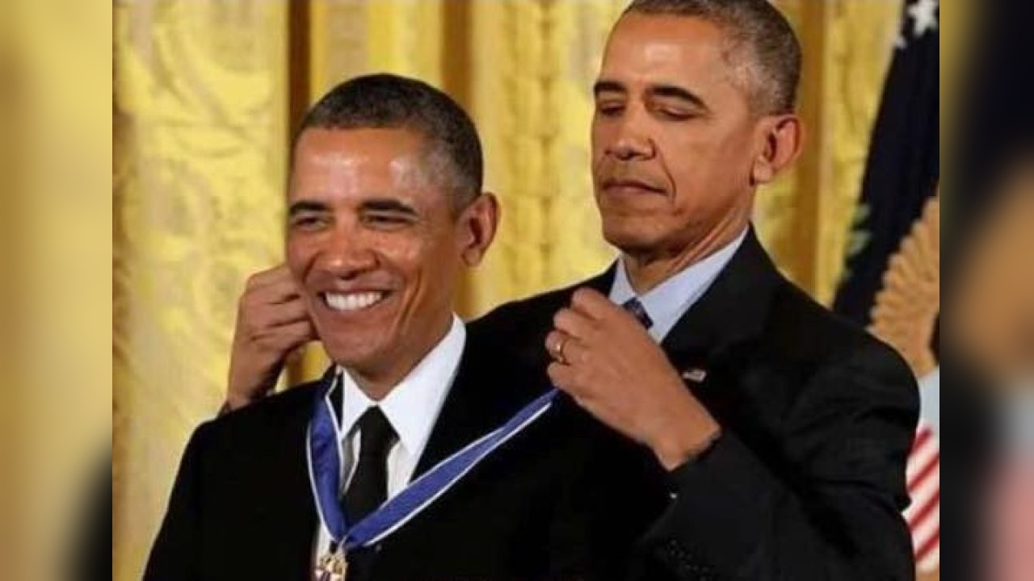

Slide 3

Pandiyan Murugan
Microsoft MVP Principal Software Engineer @ lightcast.io

Slide 4
Building SaaS application on Azure
Pandiyan Murugan

Slide 5
What is the most difficult thing to build?
SaaS?
PaaS?
IaaS?

Slide 6

Building attention after good lunch :)

Slide 7
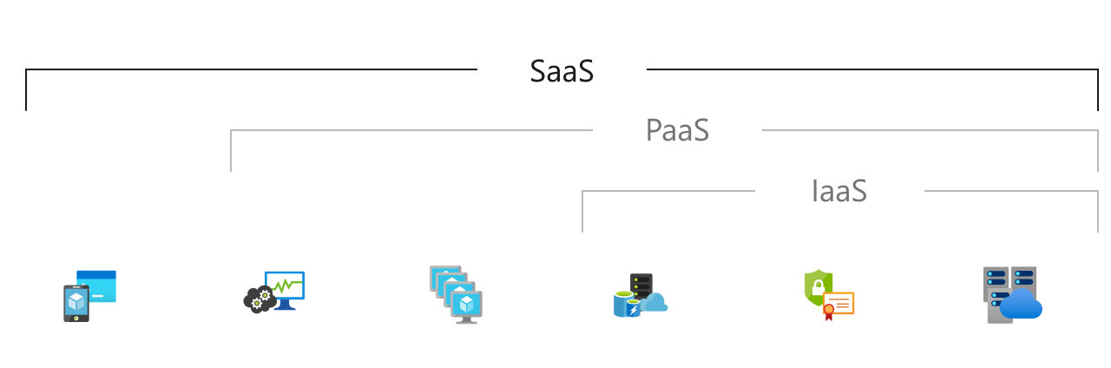
What is SaaS?
Software as a service (SaaS) allows users to connect to and use cloud-based apps over the Internet. Common examples are email, calendaring, and office tools (such as Microsoft Office 365).
SaaS provides a complete software solution that you purchase on a pay-as-you-go basis from a cloud service provider. You rent the use of an app for your organization, and your users connect to it over the Internet, usually with a web browser.

Slide 8
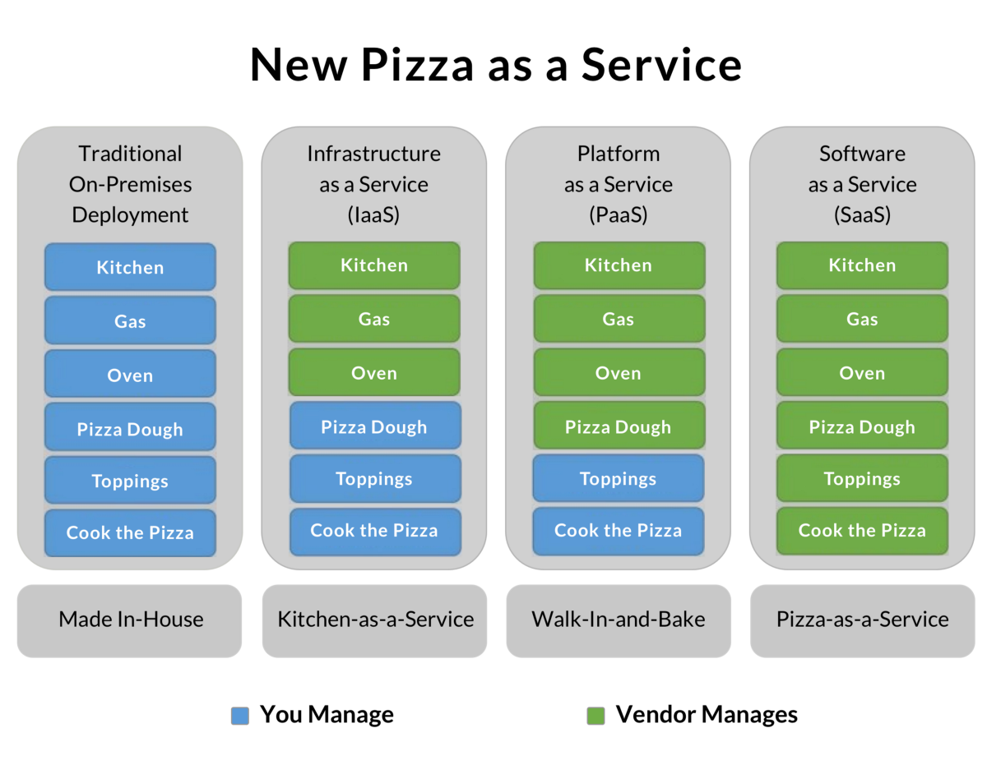

Slide 9
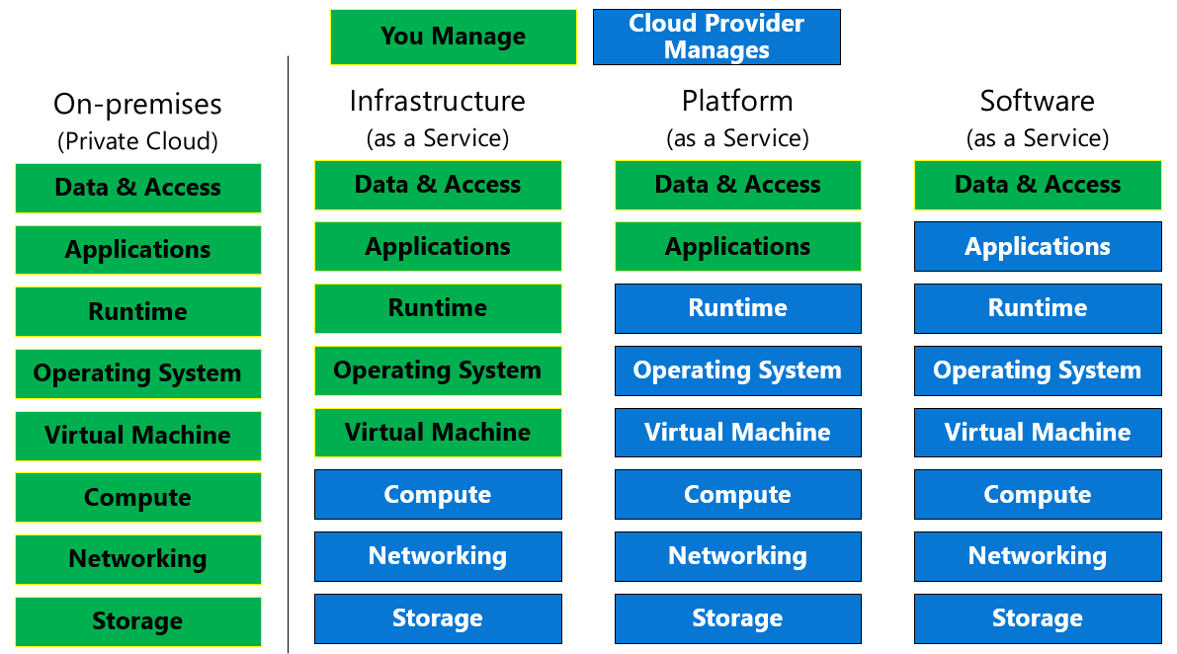

Slide 10
What I have tried to build?
A train schedule search app, which uses
Azure AD - Active Directory - Sign in users
Static Web Apps - To host web app
Azure function - Provides data over http request
API - CRUD operation of data manage
GitHub - Version control
Azure pipelines - Seamless deployment
And everything is on azure environment ❤️

Slide 11






Platinum Partner
Gold Partner
Silver Partner

Slide 13
THANK YOU!
Building Saas Application on Azure
Pandiyan Murugan
@pandiyan_cool
efficientuser.com
github.com/pandiyancool

